Slide 1
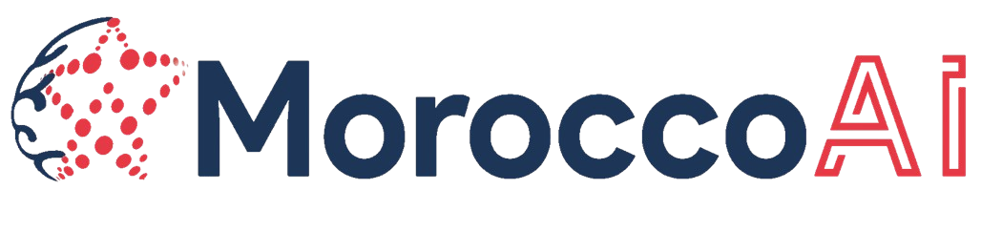


Team Name: AQUASHARING
City Name: Rabat
Project Name: Intelligent system for managing and sharing agricultural water based on the internet of things, artificial intelligence and blockchain technology.
Slogan: « Sharing Water Empowering Communities »
MoroccoAI
AQUASHARING
Notes:
"Good morning, everyone.
We are the AQUASHARING team, a group of five dedicated members proudly representing Morocco. Our mission is to revolutionize water management in agriculture by creating a system that not only addresses critical challenges such as water scarcity, food security, and the livelihoods of rural communities but also paves the way for a more sustainable and equitable future rooted in community-driven farming. Our slogan, 'Sharing Water, Empowering Communities,' reflects our vision of fostering collaboration, innovation, and sustainability to tackle the pressing issue of water scarcity.

Slide 2
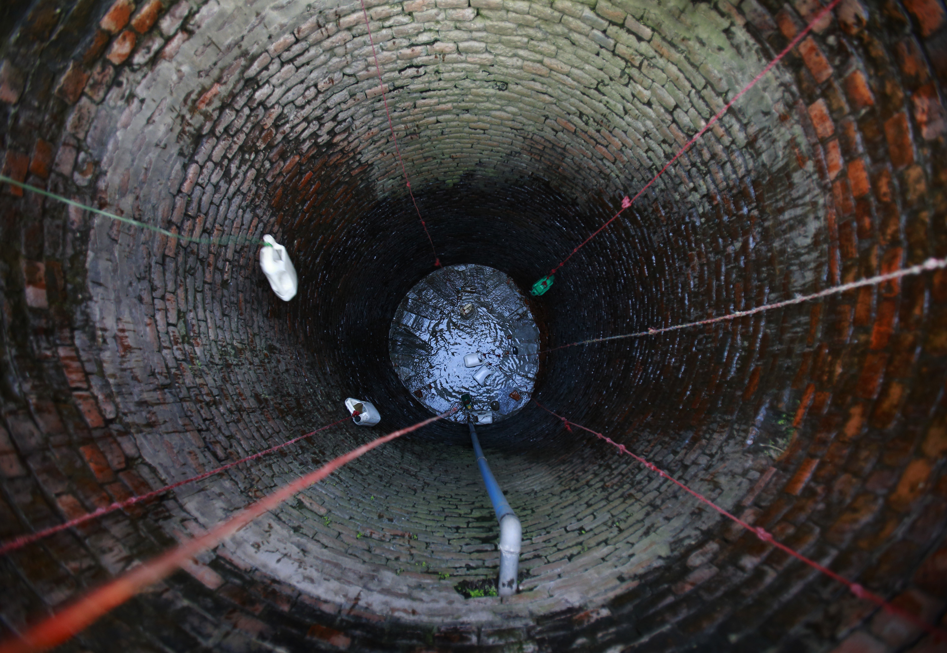
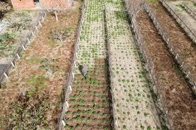
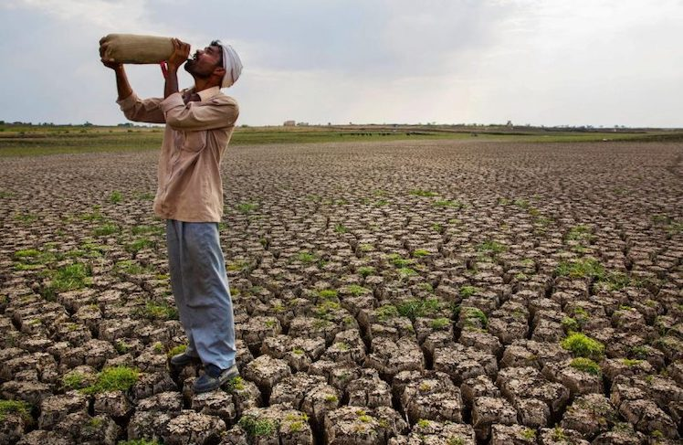
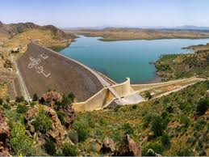
Storytelling
MoroccoAI
AQUASHARING
1
Notes:
Our idea come across when we visited various Moroccan farms and had the privilege of meeting and listening to farmers. These visits revealed the true scale of the challenge. Many farmers shared their struggles in deciding when and how to irrigate their crops. With limited access to water, they often had to prioritize irrigating one section of their fields while leaving others to wait—sometimes for days—until their water tanks could refill. This not only resulted in water shortages but also encouraged inefficient irrigation practices, relying on traditional methods without the benefit of data or intelligence.
In our discussions, we noticed a significant shift in behavior: as water sources became scarcer, trust among community members started to erode. Without trust, collaboration among farmers diminished, and the spirit of community that once united them gave way to isolation. Each farmer was left to fend for themselves, struggling to distribute water fairly and sustainably.
This inspired us to ask: Why not revive the concept of water-sharing communities? Communities that, in the past, worked together to distribute water equitably and address shared challenges. We believe that by combining this traditional model with modern technology—such as predictive intelligence, data-driven decision-making, and smart water management systems—we can restore trust, enhance collaboration, and address the critical issue of water scarcity.
Our proposal is to empower these communities to face climate change and ensure the sustainability of water resources by integrating innovative solutions. AQUASHARING is about more than just managing water—it’s about rebuilding trust, strengthening community bonds, and creating a sustainable future for agriculture in Morocco.

Slide 3
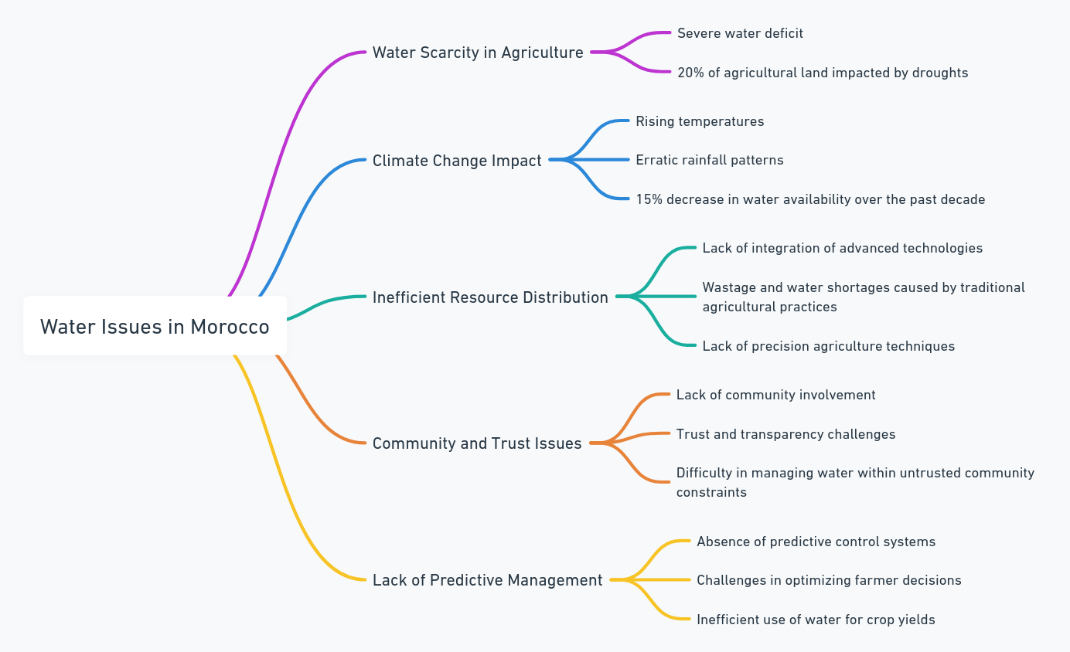
MoroccoAI
AQUASHARING
2
Notes:
Morocco faces significant water challenges that threaten its agricultural sector, communities, and environment. Severe water scarcity impacts 20% of agricultural land, exacerbated by climate change, with rising temperatures and erratic rainfall reducing water availability by 15% in the last decade. Inefficient resource distribution, driven by traditional agricultural practices and the lack of precision agriculture, further contributes to water wastage and shortages. Additionally, trust and transparency issues within communities hinder collaboration and effective water management, while the absence of predictive tools leaves farmers unable to make informed decisions, resulting in inefficient water use and lower crop yields. These interconnected issues demand urgent attention to ensure water sustainability and community resilience.

Slide 4
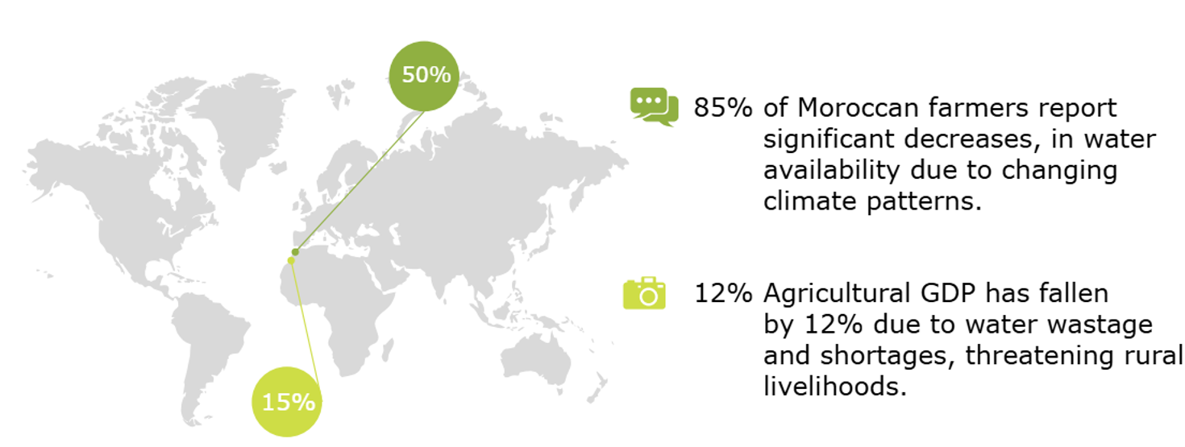
MoroccoAI
AQUASHARING
3
Notes:
The challenges of water scarcity in agriculture are profound and multifaceted. Climate change has drastically reduced water availability, with 85% of Moroccan farmers reporting significant declines in the resources they rely on to sustain their crops. Compounding this issue is a stark inequality: only 15% of small-scale farmers have access to advanced irrigation systems, leaving the majority without the tools needed to adapt. Meanwhile, urban areas consume over 50% of the nation's water, intensifying the strain on rural agricultural communities. These shortages have also triggered a 12% drop in Morocco's agricultural GDP, threatening livelihoods across the nation.
But there is hope. AQUASHARING aims to bridge these gaps by leveraging innovative technology for equitable and efficient water management. Let’s explore how this solution works and the transformative impact it promises

Slide 5




Proposed Platform
IoT technology Integration
AI for Optimization
Proposed
Platform
Reviving Communities &
Promoting Collaboration
Blockchain Security & Trust
MoroccoAI
AQUASHARING
4
Notes:
Our proposed platform, AQUASHARING, is designed to revolutionize water management in agriculture through the integration of advanced technologies. At its core, the platform brings together IoT technology for real-time monitoring of water use and soil conditions, enabling precise management of resources. Artificial intelligence further enhances the system by optimizing irrigation schedules to maximize efficiency and sustainability. Blockchain technology ensures data security, transparency, and trust among users, promoting equitable water distribution. Finally, the platform emphasizes community revival and collaboration, fostering collective efforts to address water challenges. Together, these components create a powerful, holistic solution for sustainable agricultural practices.

Slide 6
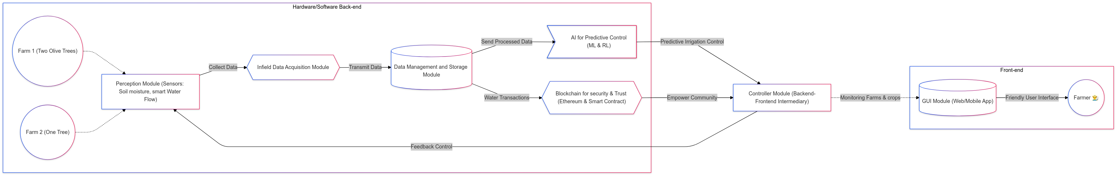
Proposed Workflow Solution
MoroccoAI
AQUASHARING
4
Notes:
Our proposed platform, AQUASHARING, is designed to revolutionize water management in agriculture through the integration of advanced technologies. At its core, the platform brings together IoT technology for real-time monitoring of water use and soil conditions, enabling precise management of resources. Artificial intelligence further enhances the system by optimizing irrigation schedules to maximize efficiency and sustainability. Blockchain technology ensures data security, transparency, and trust among users, promoting equitable water distribution. Finally, the platform emphasizes community revival and collaboration, fostering collective efforts to address water challenges. Together, these components create a powerful, holistic solution for sustainable agricultural practices.

Slide 7
Swot analysis
Strengths
opportunities
Innovative Technology Integration Cutting-edge technology integration with IoT, AI, and blockchain
Focus on smart community-driven water management solutions.
Growth of smart agriculture
Technological Advancements
Increasing focus on sustainability
Weaknesses
Threats
Early-stage development
High initial funding needs and Requirements
Competition
Navigating complex regulatory landscapes
MoroccoAI
AQUASHARING
5
Notes:
Our SWOT analysis offers a clear perspective on AQUASHARING's position. Our strength lies in integrating cutting-edge technologies like IoT, AI, and blockchain, enabling us to deliver innovative, real-time water management solutions. However, as a startup in the early stages, we face challenges such as high initial funding needs and limited market penetration.
Looking ahead, we see tremendous opportunities in building partnerships with municipalities, capitalizing on the growth of smart agriculture, and addressing the increasing global focus on sustainability. On the flip side, we must remain vigilant about competition from established solutions and navigate complex regulatory landscapes. These insights will guide our strategic decisions as we scale AQUASHARING to create impactful and sustainable change.

Slide 8
MARKET SIZE
Market
Potential
Revenue Projections
Potential Users
65%
of Morocco’s
Rural population.
Target Market Segments
Competitive Landscape
15 M
Potential
farmers
25 M
Revenue
MoroccoAI
AQUASHARING
6
Notes:
The market potential for AQUASHARING is both promising and impactful. Our primary focus is on agricultural regions, which account for 65% of Morocco’s rural population. This translates into an estimated 22 million potential users, showcasing a vast audience ready to adopt our platform. With these projections, we anticipate generating $25 million in revenue over the next five years. Additionally, the competitive landscape remains relatively untapped in the domain of water-sharing technologies, giving AQUASHARING a critical first-mover advantage. By targeting this niche, we can establish ourselves as an industry leader in sustainable water management solutions.

Slide 9
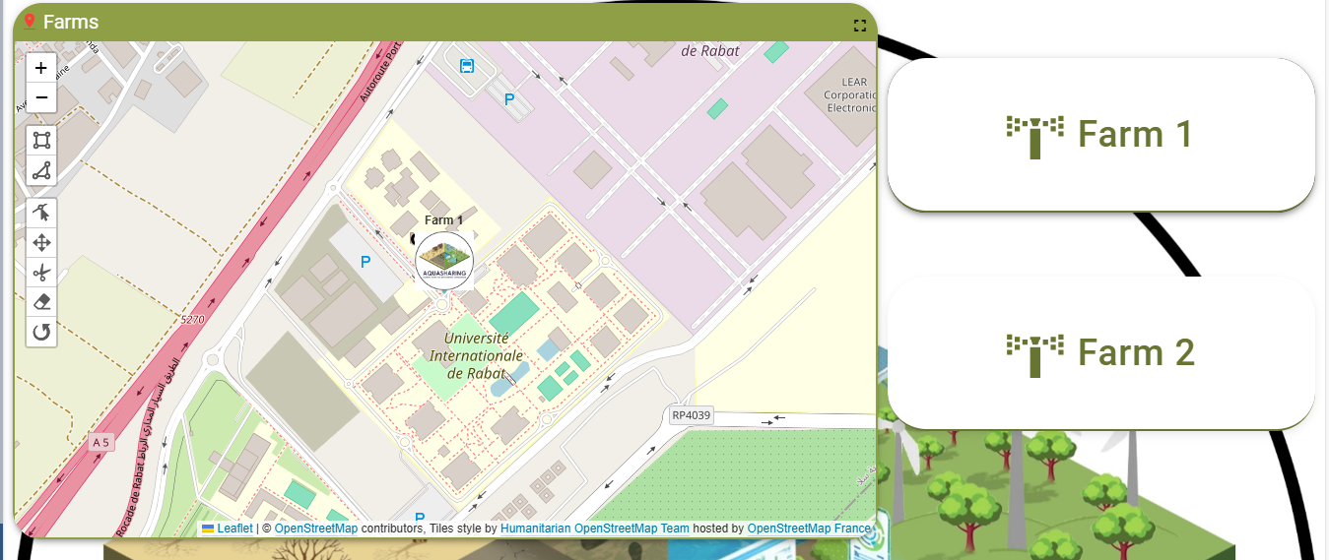
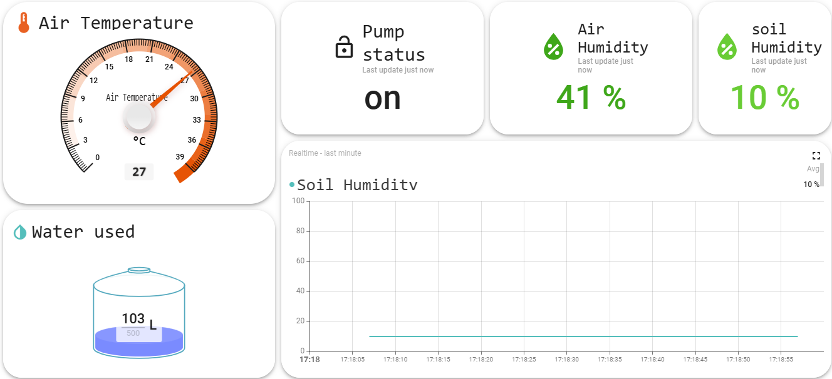
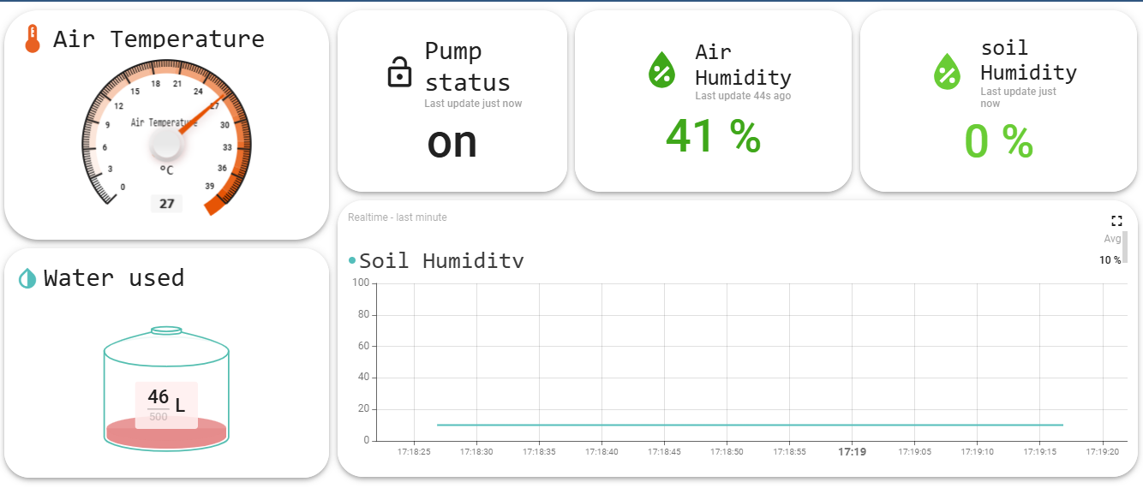
Product Overview
24 M
MoroccoAI
AQUASHARING
7
Notes:
This slide showcases the AQUASHARING platform and its key features. At the core of our system is a user-friendly dashboard that integrates real-time data from IoT sensors deployed across farms. As you can see, the dashboard provides critical metrics such as air temperature, soil humidity, pump status, and water usage. For example, in Farm 1 and Farm 2 displayed here, users can monitor soil conditions and adjust irrigation systems based on precise, real-time insights.
Our interactive map interface helps farmers visualize their land, manage water distribution, and track environmental changes effortlessly. The platform also ensures accessibility through a QR code, which allows instant connection to our services, whether on mobile or desktop devices. AQUASHARING is designed to make data-driven decisions easy, empowering users to conserve water, improve crop yields, and foster sustainable practices. With this platform, farmers and stakeholders can gain unprecedented control over their resources.

Slide 10
Custode segment
Channels
Farmers in Morocco and Africa Agricultural coopératives, Rural communities in Morocco and Africa
Mobile application
Web3 platform
partnerships with municipalities and NGOs
Value proposition
Custode relationships
Focus on building trust within communities
Technology innovation in precision agriculture
Promoting community engagement
Enabling sustainable farming practices.
Empowers farmers with equitable water access Optimized irrigation and water wastage through A Security, trust, Transparency through blockchain.
Ravenue streams
Subscription-based services
Usage-based fees
Partnerships with government and private stakeholders
MoroccoAI
AQUASHARING
8
Notes:
Our business model is tailored to address the specific needs of AQUASHARING's target audience while ensuring long-term sustainability. Our primary customer segments include farmers, agricultural cooperatives, and rural communities, all of whom benefit from better water management solutions. Our value proposition focuses on providing equitable water access, optimizing irrigation through real-time data, and enhancing transparency with blockchain technology.
To reach our users, we employ a multi-channel strategy that includes a mobile application, web platform, and partnerships with municipalities and NGOs. We emphasize building strong customer relationships through trust, community engagement, and promoting sustainable practices. Revenue is generated through subscription-based services, usage fees, and collaborations with both government and private stakeholders. This comprehensive approach ensures that AQUASHARING is impactful, scalable, and financially sustainable

Slide 11
Impact – Vision
A New Way Of Thinking In Water Management
Launch AQUASHARING in key agricultural small-scale farms, achieving a 20% reduction in water waste within the first year.
Reach 100,000 active farmers within the first year
Collaborate with Partnerships to enhance adoption and penetration
Expand Community Driven Energy Microgrids
Integrate advanced technologies to optimize water resource management and sharing within the African agriculture sector.
LONG TERM
SHORT TERM
MoroccoAI
AQUASHARING
9
Notes:
Our vision for AQUASHARING is ambitious and transformative, redefining how water is managed and shared in agriculture. In the short term, we plan to launch AQUASHARING in key agricultural small-scale farms, achieving a 20% reduction in water waste within the first year. Additionally, we aim to reach 100,000 active farmers by providing them with the tools and support to adopt sustainable water management practices. Strategic collaborations with municipalities, NGOs, and other stakeholders will enhance adoption and penetration, ensuring maximum impact.
Looking at the long term, our focus shifts to expanding community-driven energy microgrids to support the platform's infrastructure. We also aim to integrate advanced technologies that will optimize water resource management and sharing within the African agricultural sector. This dual approach, balancing immediate goals with a forward-thinking vision, positions AQUASHARING as a leader in driving efficiency, sustainability, and resilience in agricultural water management.

Slide 12
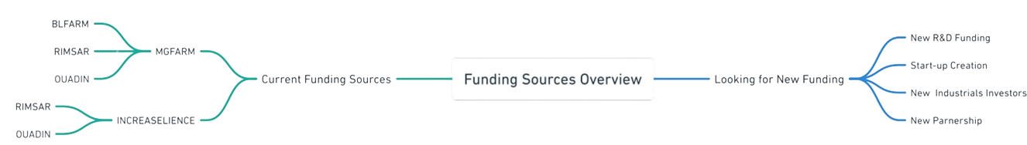
Seeking Funding
A New Way Of Thinking In Water Management
MoroccoAI
AQUASHARING
9
Notes:
Our vision for AQUASHARING is ambitious and transformative, redefining how water is managed and shared in agriculture. In the short term, we plan to launch AQUASHARING in key agricultural small-scale farms, achieving a 20% reduction in water waste within the first year. Additionally, we aim to reach 100,000 active farmers by providing them with the tools and support to adopt sustainable water management practices. Strategic collaborations with municipalities, NGOs, and other stakeholders will enhance adoption and penetration, ensuring maximum impact.
Looking at the long term, our focus shifts to expanding community-driven energy microgrids to support the platform's infrastructure. We also aim to integrate advanced technologies that will optimize water resource management and sharing within the African agricultural sector. This dual approach, balancing immediate goals with a forward-thinking vision, positions AQUASHARING as a leader in driving efficiency, sustainability, and resilience in agricultural water management.

Slide 13
Conclusion
WHY AQUASHRING?
MoroccoAI
AQUASHARING
11
Notes:
Why AQUASHARING? Because we are addressing one of the most critical challenges of our time—water scarcity in agriculture—with a comprehensive and innovative solution. Our platform combines cutting-edge technologies like IoT, AI, and blockchain to create a system that is not only efficient but also equitable and transparent. We are empowering farmers and rural communities with the tools to optimize water use, increase crop yields, and secure their livelihoods in the face of climate change.
What sets us apart is our vision for the future. We are not just solving a problem; we are building a movement for sustainable water management, fostering collaboration, and ensuring long-term resilience for agriculture. With a deep understanding of the challenges and a clear roadmap to scalability, AQUASHARING is the right partner to drive meaningful and lasting impact. Together, we can redefine how water resources are managed and shared, creating a brighter, more sustainable future for all.

Slide 14
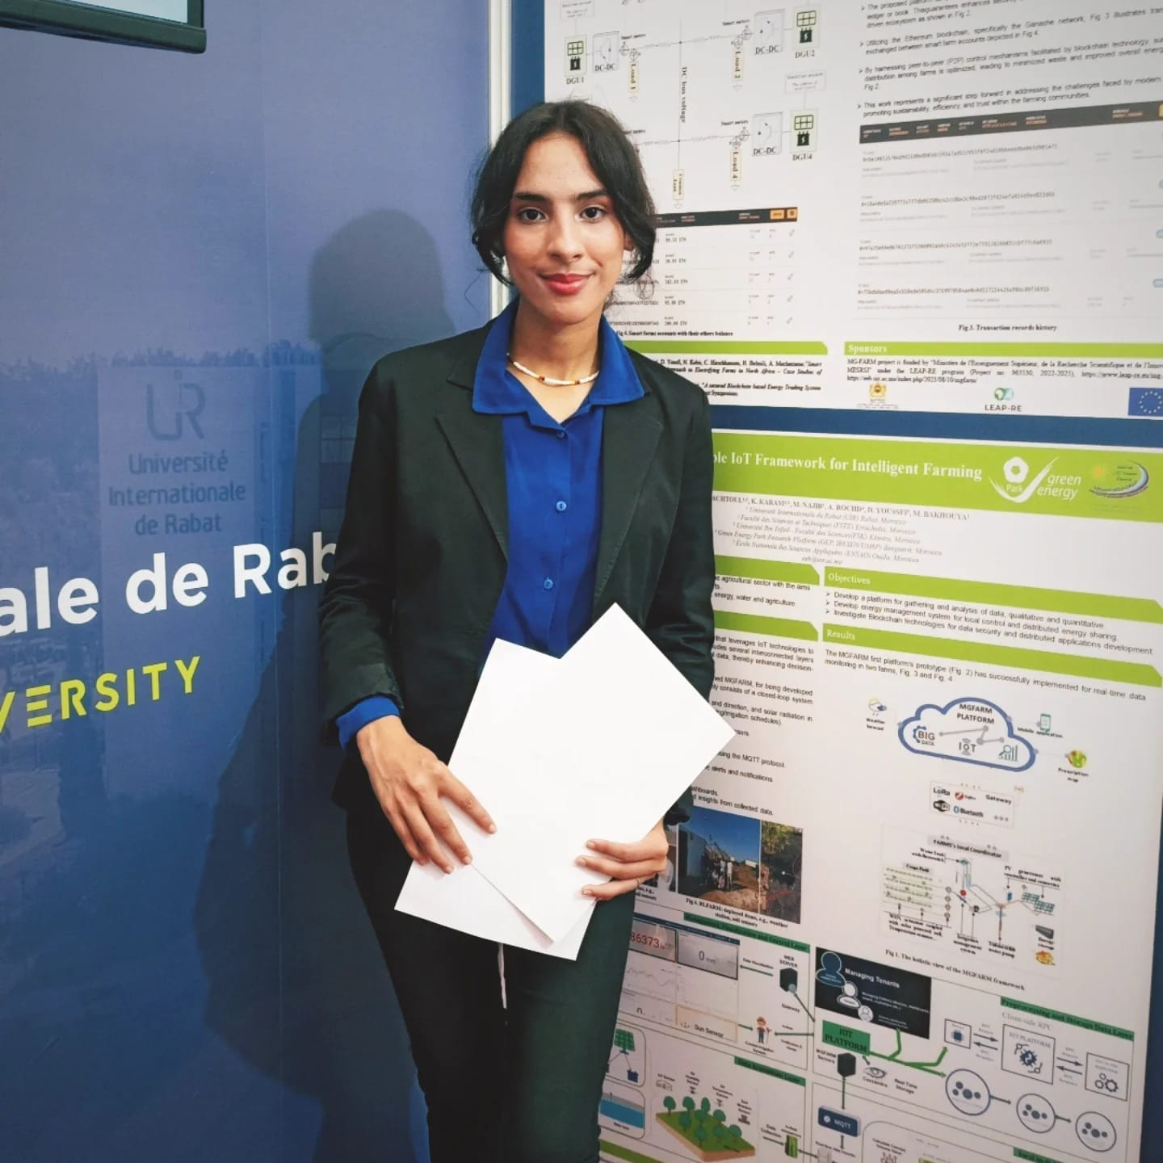
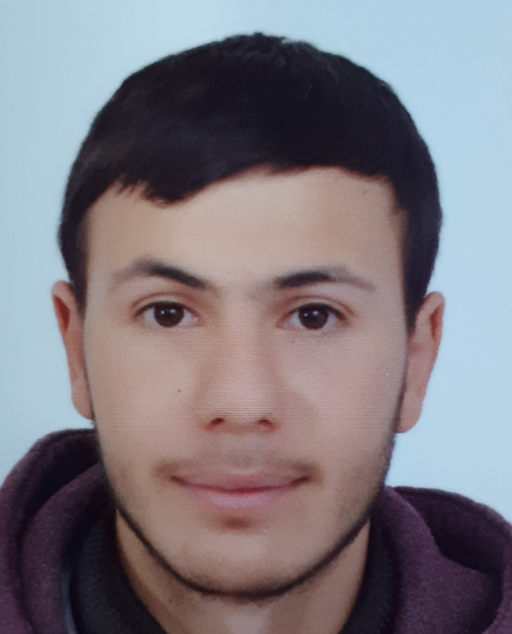
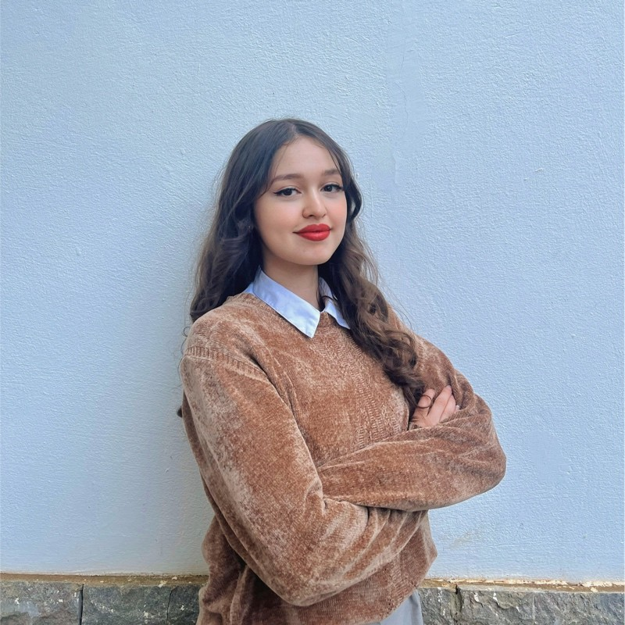
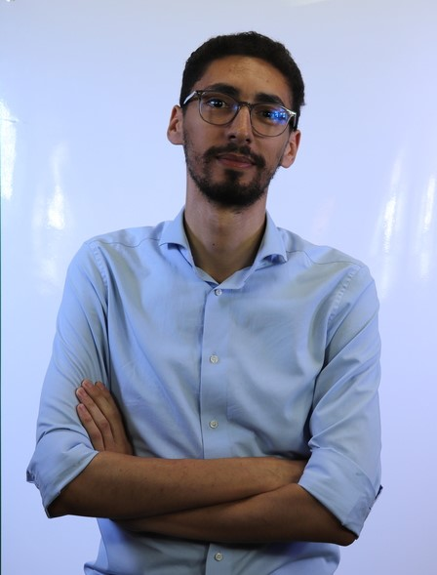
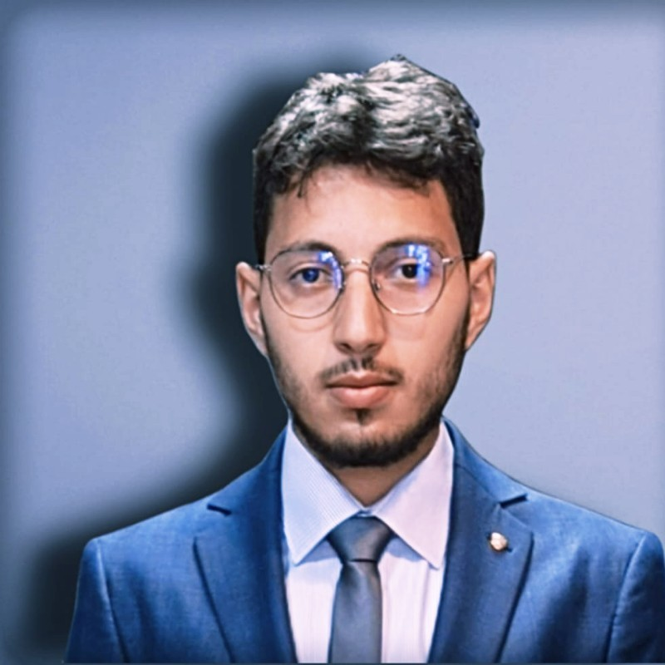
AQUASHARING
(Team membres)
AQACHTOUL
Abderrahmane
KARAM Khaoula
ELAMRANI
Abderrahmane
CHAHI Sarah
NOUFEL Saad
MoroccoAI
AQUASHARING
10

